Slide 1
Welcome to CS10 Group Third Meeting
Team member
Wilma Liu
Fiona Hu
Pat Zhang
Elvia Tong
Reehaa Ding
William Quan

Slide 2












Project structure
Problem identification
Support identification
Support recommendation
(Machine learning)
Problem Data Analysis
Support data analysis

Slide 3

We are here this week
Problem identification
Support identification
Support recommendation
(Machine learning)
Problem Data Analysis
Support data analysis

Slide 4
How we identify the problems
Impact of the COVID-19- case, economy downturn
Cases：
Cases have been consistently increased since 2020
COVID-19 timeline info
COVID-19 response, recovery and impact
ABS Statistics
Economy：
Economy’s downturn since 2020
Economy trend from 2020 to 2023
COVID-19 response, recovery and impact

Slide 5
How we identify the problems
Impact of the COVID-19 to different departments
Health
Customer Service
Treasury
Education
Planning, Industry and Environment

Slide 6
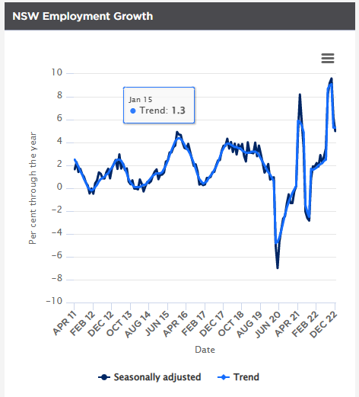
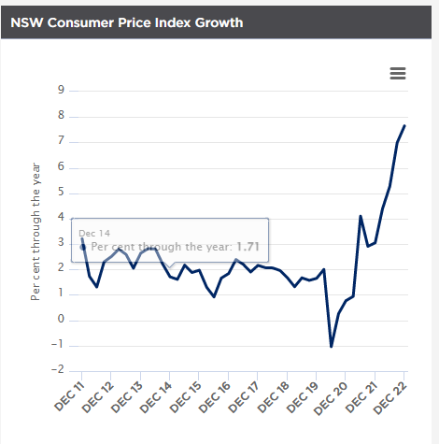
Problem data analysis- data collection
Cases
Collect COVID-19 data
Cases by locations and postcodes
Cases by age groups
Economy
Refer to the NSW treasury

Slide 7

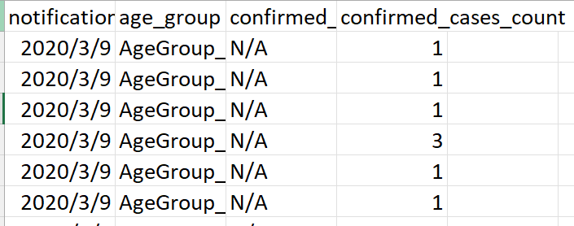
Problem data analysis- data collection
Cases by locations and postcodes
Cases by age groups

Slide 8
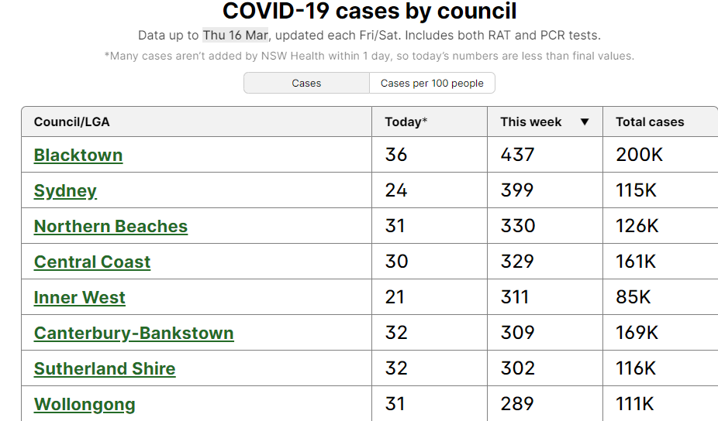
Problem data analysis- data collection

Slide 9
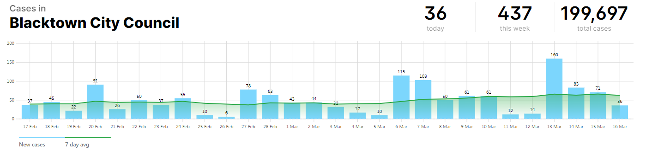
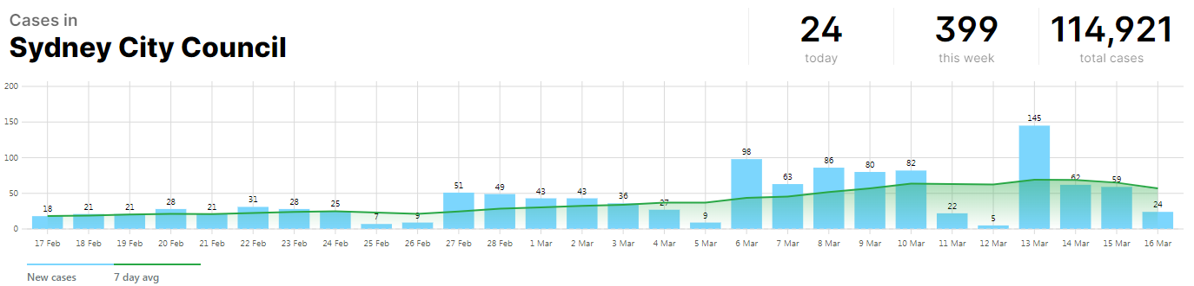
Problem data analysis- data collection

Slide 10
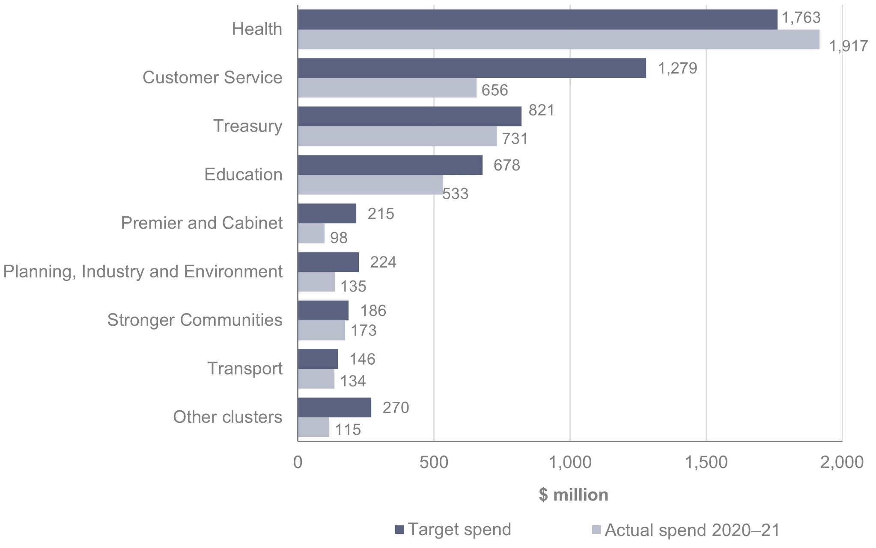
Support identification- COVID-19 response

Slide 11

Support identification- Suggested supports
Vaccinations
Dine & Discover voucher
Small business recovery grants

Slide 12
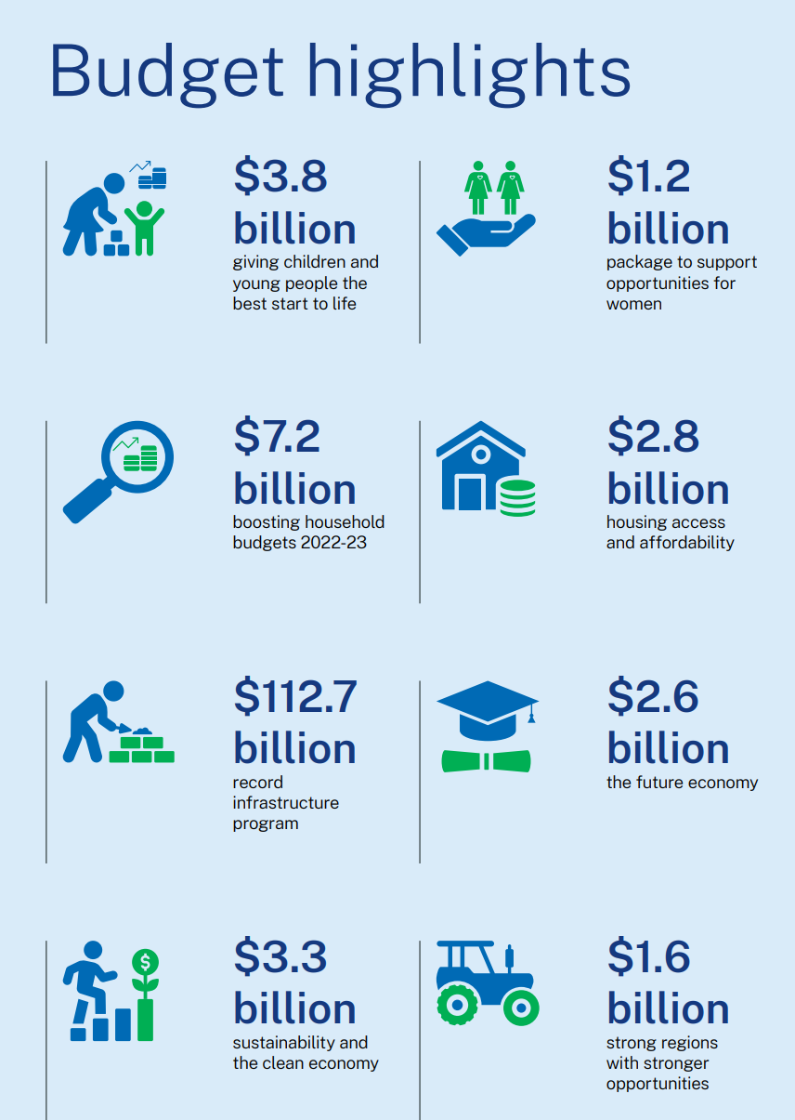
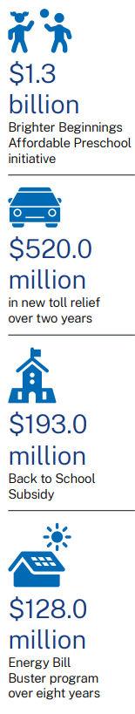

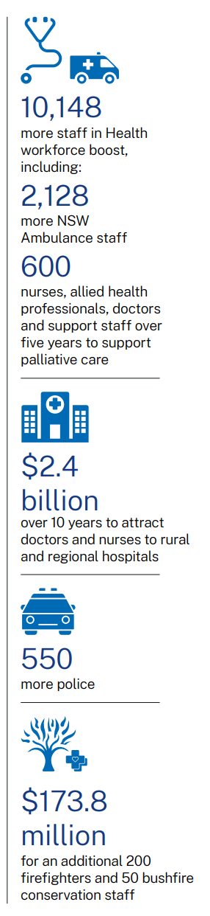
Support identification- 2023 NSW Budget
2023 NSW Budget
Supporting families

Slide 13
Support data analysis- without support data
Analysing problem impact data
Analysing the ages, regions of the cases
Analysing other problem impact data
Predicting the future cases by ages, regions
Define the success measure in qualitative way
Recommendations of the support

Slide 14
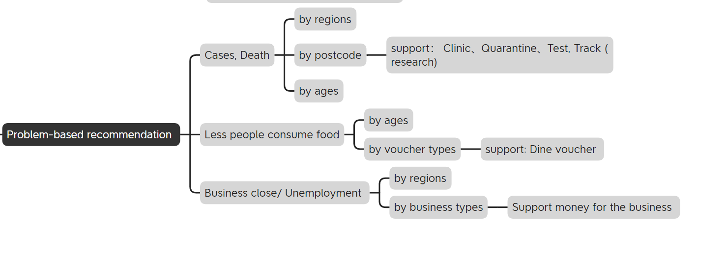
Support data analysis- without support data

Slide 15
Support data analysis- with support data
Analysing support data
After applying the vaccination (data)
After applying the vouchers
After applying the small business recovery grants
Predicting the success of each support by segmentation
Recommendations of the support by segmentation
Challenge:
Lack of completed support data
Need strong background knowledge about the support policy

Slide 16
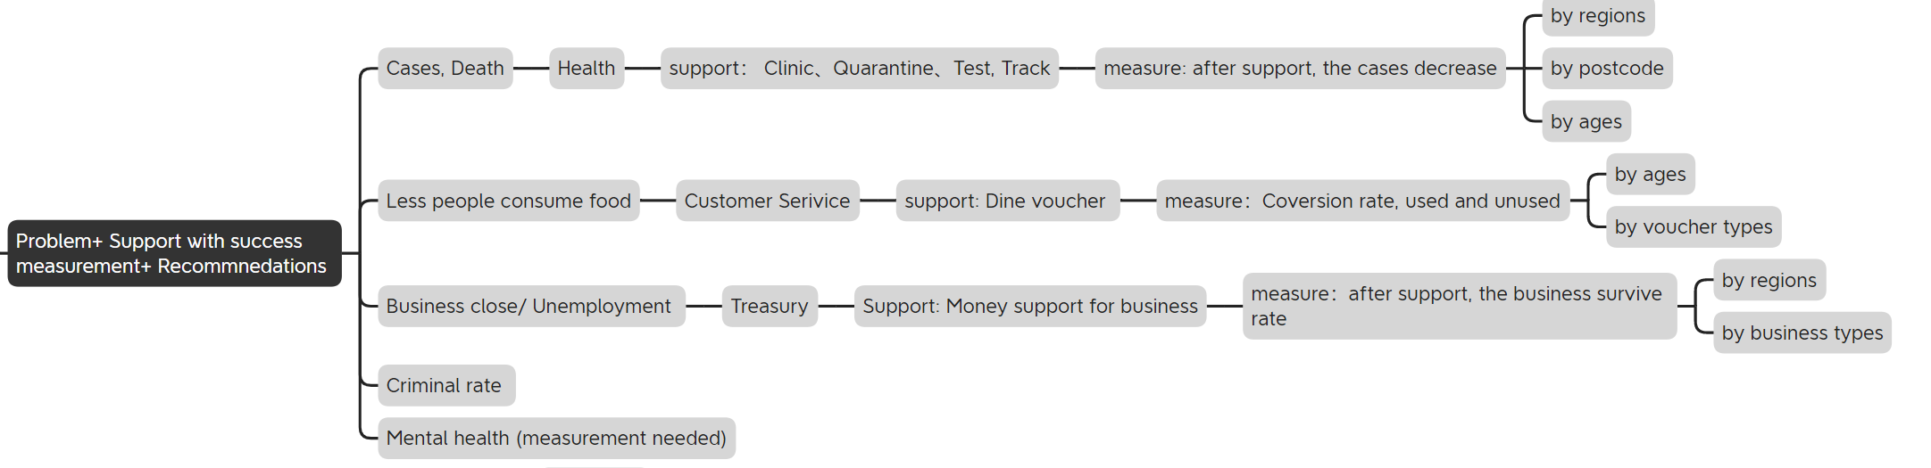
Support data analysis- with support data

Slide 17
Thank you !!!

